Slide 1
CSE4004 – Web Technologies
Web Communication & HTML

Slide 2
Web Essentials
Client: web browsers, used to surf the Web
Server systems: used to supply information to these browsers
Computer networks: used to support the browser-server communication
Request “document A”
document A
Client
Server

Slide 3
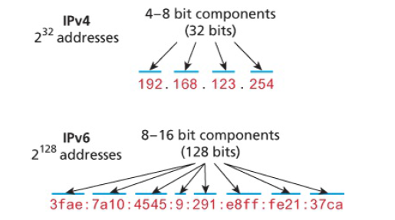
IP Address

Slide 4
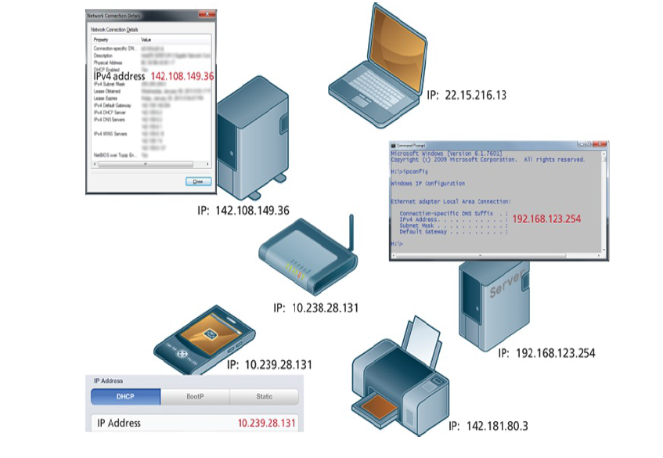
IP Address

Slide 5
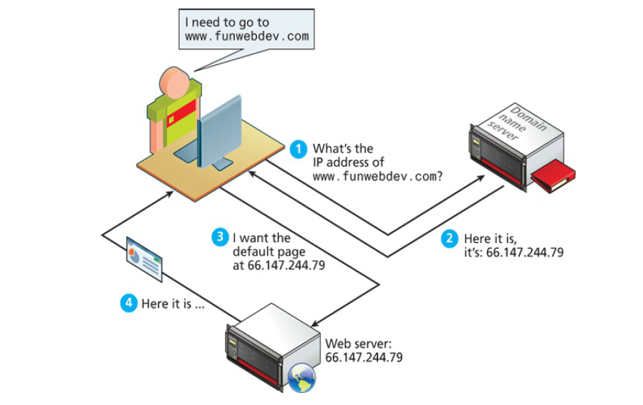
Web Server

Slide 6
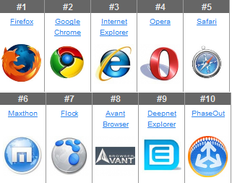
Web Client/Browsers

Slide 7
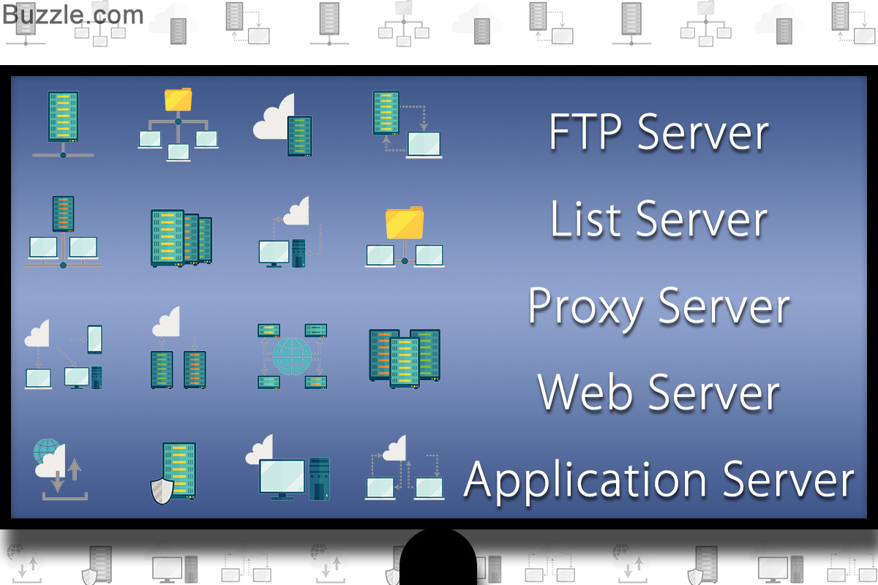
Servers

Slide 8








Web Servers

Slide 9
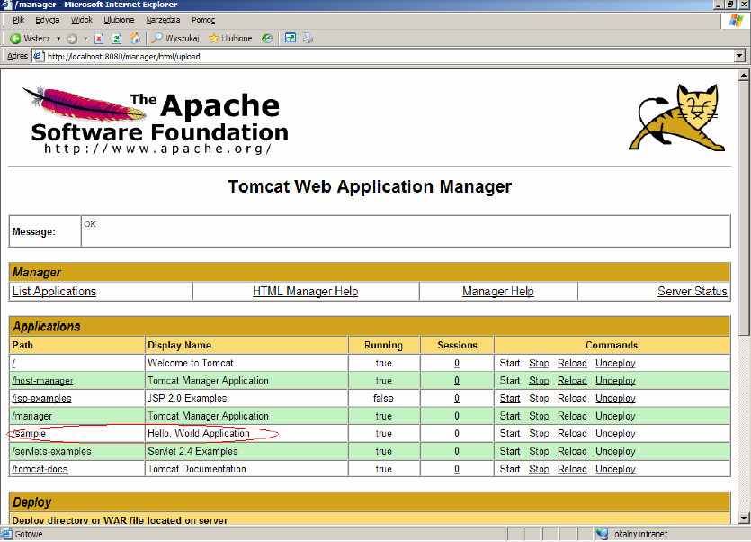
Web Server Home Page

Slide 10
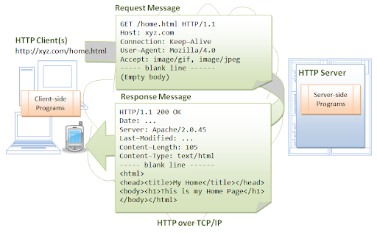
Web Client and Server Communication

Slide 11
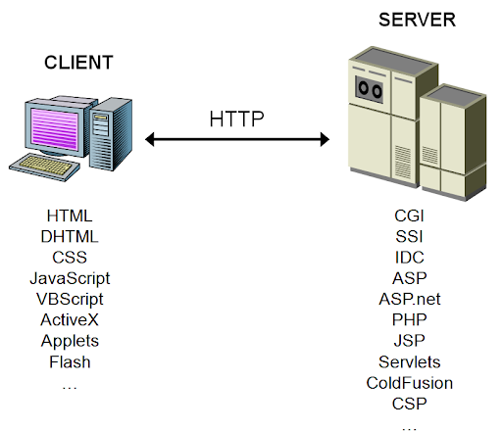
Web Client and Server Programming

Slide 12
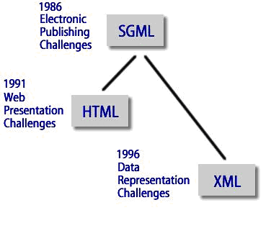
Markup language
defines the structure and content of hypertext documents

Slide 13
HTML – Hyper Text Markup Language
HTML documents are simply text documents with a specific form
  Documents comprised of content and markup tags
  Content: actual information being conveyed
  The markup tags tell the Web browser how to display the page
  An HTML file must have an htm or html file extension
  An HTML file can be created using a simple text editor

Slide 14
HTML Tags
HTML tags are used to mark-up HTML elements
  Surrounded by angle brackets < and >
  HTML tags normally come in pairs, like <tagname> (start tag) and </tagname> (end tag)
  The text between the start and end tags is the element content
  Not case-sensitive

Slide 15
Tag attributes
Tags can have attributes that provide additional information to an HTML element
  Attributes always come in name/value pairs like: name=“value”
  Attributes are always specified in the start tag
  Attribute values should always be enclosed in quotes. Double quotes are most common.
  Also case-insensitive: however, lowercase is recommended
  <tagname a1=“v1” a2=“v2”></tagname>
  For example, <table border=“0”> is a start tag that defines a table that has no borders

Slide 16
HTML Document Structure
Entire document enclosed within <html> and </html> tags
Two subparts:
  Head
    Enclosed within <head> and </head>
    Within the head, more tags can be used to specify title of the page, meta-information, etc.
  Body
    Enclosed within <body> and </body>
    Within the body, content is to be displayed
    Other tags can be embedded in the body

Slide 17
Sample HTML Page
<!DOCTYPE>
<html lang="en">
<head>
<meta charset="UTF-8">
<title>Your Page TITLE goes here</title>
<meta name="viewport" content="width=device-width, initial-scale=1.0">
</head>
<body>
<p>Your Page CONTENT goes here. The p tag indicates that this is a
paragraph</p>
</body>
</html>

Slide 18
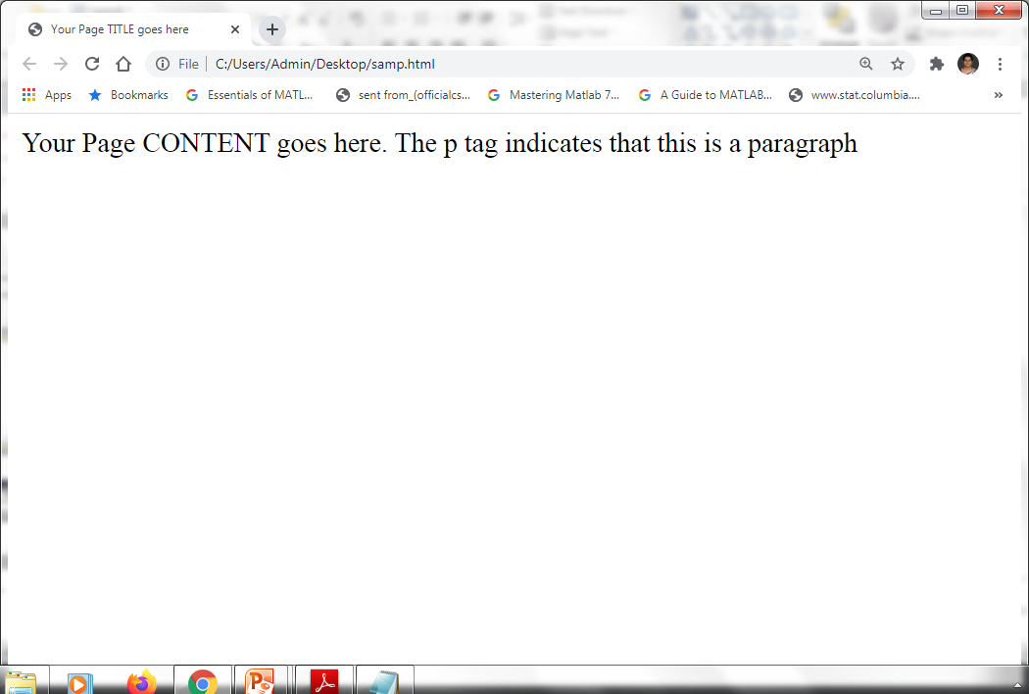
Sample HTML Page in Browser

Slide 19
HTML Vs XML
HTML | XML
HTML is a presentation language | XML is a data transportation and storage
HTML uses fixed set of tags | XML may have user defined tags
Browsers tolerant to errors | XML must be well-formed (syntactically correct)

Slide 20
XHTML
XHTML is a stricter and cleaner version of HTML
  eXtensible HyperText Markup Language
  aimed to replace HTML
  identical to HTML 4.01
  combination of HTML and XML
  W3C Recommendation
XHTML elements must be properly nested
XHTML elements must always be closed
XHTML elements must be in lowercase
XHTML documents must have one root element

Slide 21
HTML
Sample HTML pages

Slide 22
What’s Ahead?
Advanced HTML features
CSS
Client Side Scripting
Server Side Scripting
Web Frameworks

